Slide 1
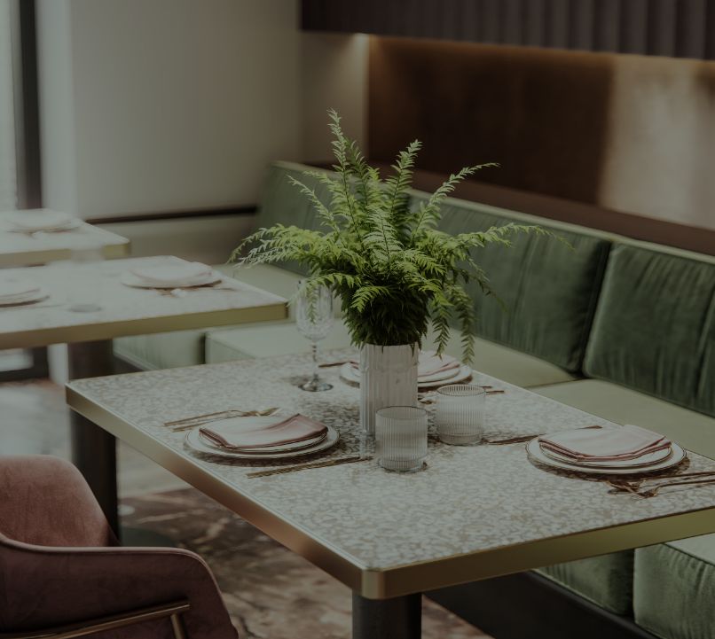
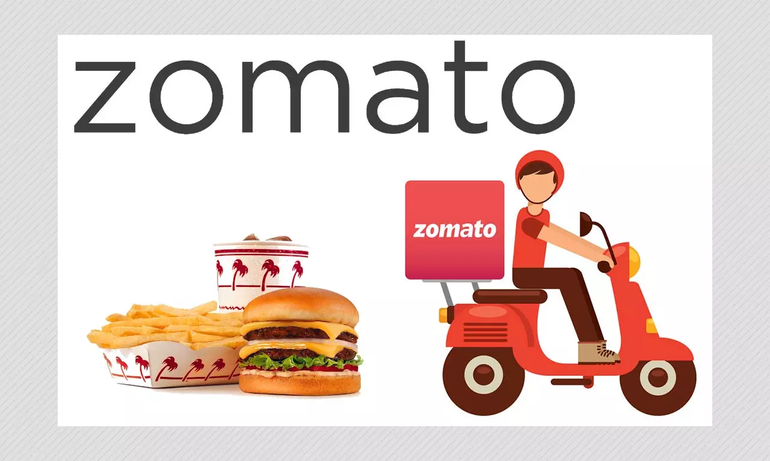
Zomato Restaurant Clustering & Sentiment Analysis
SAMBIT PANI​​

Slide 2
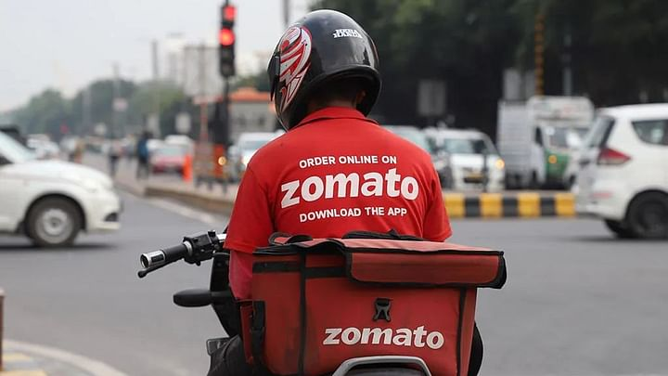
Contents
Problem Statement
Dataset description
Data wrangling
EDA
Feature engineering
Data pre-processing
K-Means Clustering
LDA
Supervised Models
Conclusion

Slide 3

Problem statement
The Project focuses on Customers and Company, you have to analyze the sentiments of the reviews given by the customer in the data and made some useful conclusion in the form of Visualizations. Also, cluster the Zomato restaurants into different segments.
The data is visualized as it becomes easy to analyze data at instant. The Analysis also solve some of the business cases that can directly help the customers finding the Best restaurant in their locality and for the company to grow up and work on the fields they are currently lagging in.
This could help in clustering the restaurants into segments. Also the data has valuable information around cuisine and costing which can be used in cost vs. benefit analysis. Data could be used for sentiment analysis.
Also the metadata of reviewers can be used for identifying the critics in the industry.

Slide 4
Data description
Restaurant Dataset:
Review Dataset:
Name : Name of Restaurants Links : URL Links of Restaurants Cost : Per person estimated Cost of dining Collection : Tagging of Restaurants as per Zomato categories Cuisines : Cuisines served by Restaurants Timings : Restaurant Timings
Restaurant : Name of the Restaurant Reviewer : Name of the Reviewer Review : Review Text Rating : Rating Provided by Reviewer Meta-Data : Reviewer Metadata - No. of Reviews and followers Time: Date and Time of Review Pictures : No. of pictures posted with review

Slide 5

Data wrangling
Restaurant Data
I have only changed the cost feature datatype from object to int.
Review Data
I have only changed the rating feature datatype from object to float.
Extracted followers and reviews from metadata.
Extracted Time, Year, Month and Hour of review_created.

Slide 6
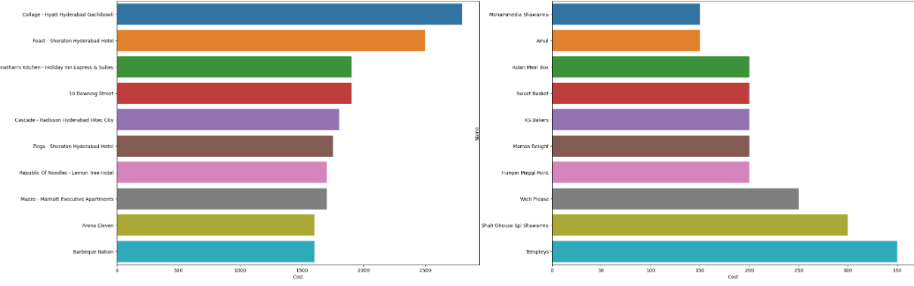
Restaurants as per cost
Checked the expensive and affordable restaurants for different class of people.

Slide 7
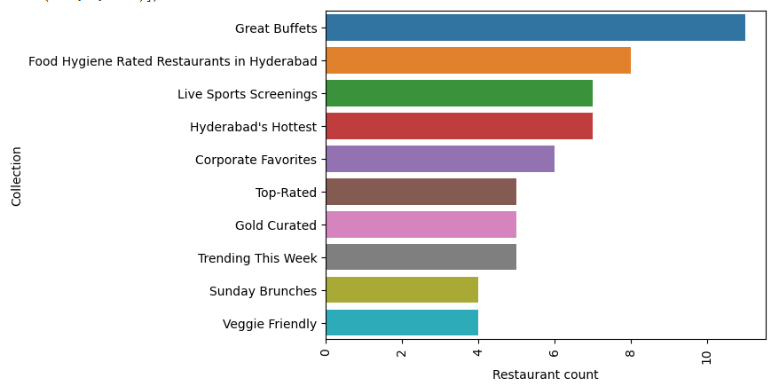
MOST COLLECTIONS
Finding out the most tagging's given by Zomato to the restaurants. These are the specific categories that the restaurant belongs to.

Slide 8
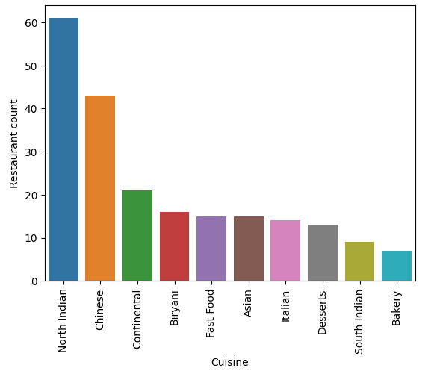
Most cuisine Served
It’s the wider variety of cuisines offered by all restaurants.
North Indian, Chinese and Continental are the mostly offered cuisines.
North Indian due to the customer are mostly from North Indian Regions.

Slide 9
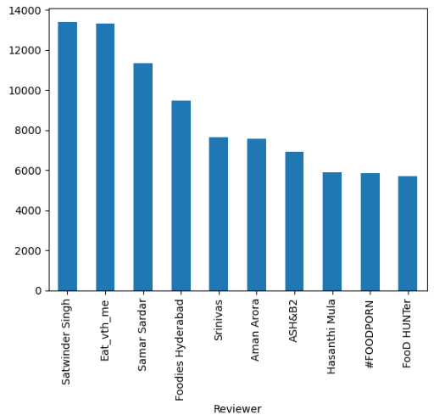
Most followed reviewer
It shows the most followed persons graph.
Its beneficial to know whose review will influence most of the people.
Satwindar Singh has the highest followers followed by Eat_vth_me.

Slide 10
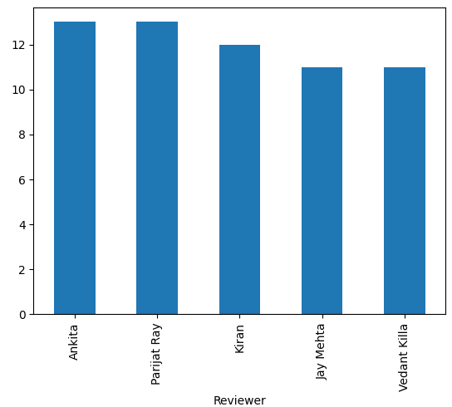
Highest reviews
The graph shows top 5 reviewers who have reviewed most number of restaurants.
Ankita and Parijat Ray are the highest reviewers with 13 reviews each.

Slide 11
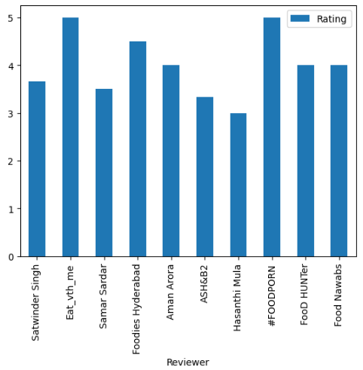
Most followed reviewer ratings
Graph Shows the most followed reviewers and their average ratings.
Eat_vth_me and #FOODPORN being the most satisfied highest followed reviewer.

Slide 12
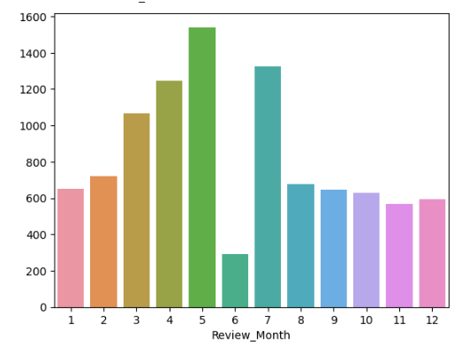
Month wise reviews
People engagement on restaurants increasing from march to may.
Also July month has more reviews.
There may be more rain during June which results in less activity or may be due to festive occasions.

Slide 13
Feature engineering & data pre-processing
Missing Imputation
As very less number of missing values are present in the review data.
So I decide to remove them.
I have imputed mean values of collection i.e. 3 which is 'Barbecue & Grill', 'Happy Hours', 'Gigs and Events' in all collection missing values.
I have imputed 0 where there is nan values in number of followers.
One-hot Encoding
I have done one hot encoding on cuisines column. Also kept average rating and Cost as they are numerical variables.
Text preprocessing
Reviews columns applied with lemmatization, stop word removal, punctuation removal, tokenization and vectorization done using TFIDF.
Feature manipulation
Sentiment column - rating above average is 1 and below average is 0.
Applied log transformation to “cost” as it is positively skewed.
PCA
Applied PCA on scaled data with components up to 3 and variance 62.69%

Slide 14
K-Means Clustering
With elbow method I get good 4 clusters.
After silhouette score I get 6 cluster giving good score.
1
2
3
4
5
6
['Chinese' 'Continental' 'Kebab' 'European' 'South Indian' 'North Indian' 'Asian' 'Mediterranean' 'Seafood' 'Goan' 'BBQ' 'Japanese' 'Italian' 'Salad' 'Sushi' 'Spanish' 'Thai' 'Momos']
['Continental' 'American' 'Chinese' 'North Indian' 'Cafe' 'Desserts' 'Bakery' 'Fast Food' 'Wraps' 'South Indian' 'Biryani' 'Hyderabadi' 'Beverages' 'Mughlai' 'Burger' 'Salad' 'North Eastern' 'Momos' 'Seafood']
['Biryani' 'North Indian' 'Chinese' 'Seafood' 'Beverages' 'Healthy Food' 'Continental' 'South Indian' 'American' 'Kebab' 'Italian' 'Finger Food' 'Mexican' 'Salad' 'Bakery' 'Mughlai' 'Juices' 'Arabian' 'Andhra' 'Hyderabadi' 'Thai' 'Indonesian' 'Asian' 'Momos' 'Desserts' 'Cafe' 'Burger' 'Fast Food']
['Lebanese' 'Ice Cream' 'Desserts' 'Fast Food' 'Asian' 'Beverages' 'Bakery' 'Momos' 'Street Food' 'Arabian' 'North Indian']
['Biryani' 'North Indian' 'Chinese' 'Asian' 'Mediterranean' 'Desserts' 'European' 'American' 'BBQ' 'Modern Indian' 'Continental' 'Sushi']
['Street Food' 'North Indian' 'Fast Food' 'Burger' 'Chinese' 'Biryani' 'Mughlai' 'South Indian' 'Desserts' 'Kebab' 'Cafe' 'Pizza']

Slide 15
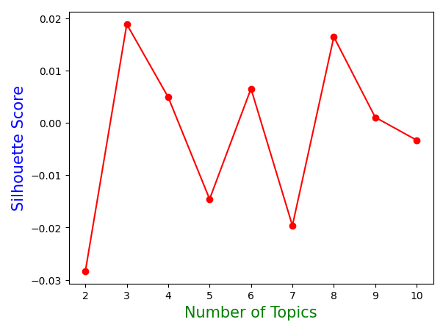
Lda method
It is a method of selecting the hidden topics from the dataset.
It is one type of unsupervised learning algorithm.
Here I have applied to understand the sentiment of the reviews.
Here I have selected 4 assuming there may be four different types of reviews which are best, good, acceptable and bad.
This is very subjective and can be changed and studied.
Visualization of words are as follows.

Slide 16
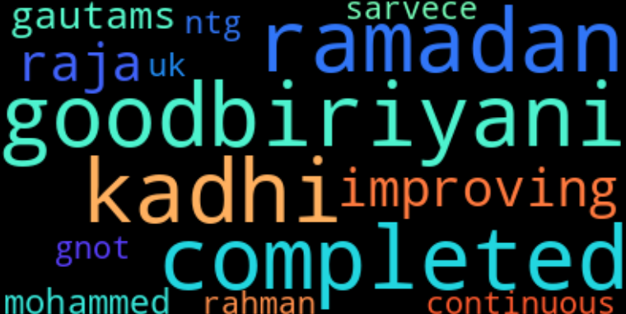
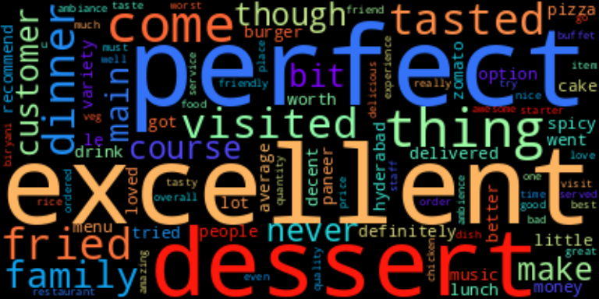
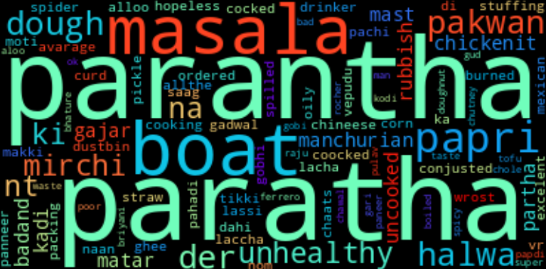
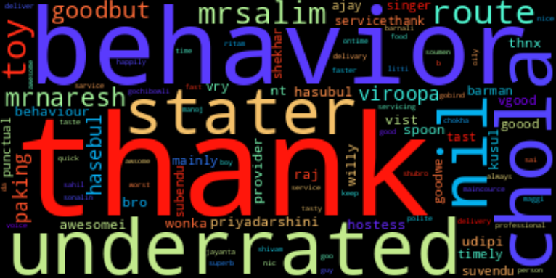
Lda word-clouds

Slide 17
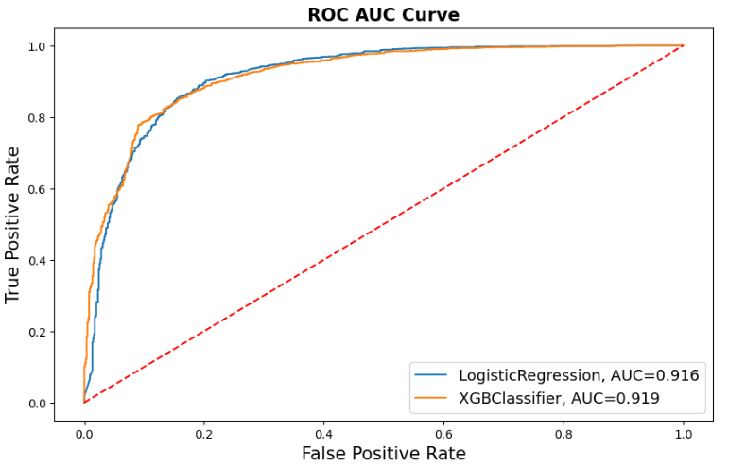
Supervised models
I have applied two algorithms. One is the Logistic regression and another is the XGBoost.
I have done a train test split ratio of 80:20 so that most of data is used to train the model.
After that I have used ROC-AUC metrics.
As ROC-AUC gives the probability of correct prediction of new observation.
Here both the models comes up with same performance.
XGBoost is slightly better score. So I choose it as the best model for this dataset.

Slide 18
Conclusion
OBSERVATIONS
From EDA, it has been found out that the most expensive restaurant is “Collage – Hyatt Hyderabad Gachibowli” and lowest is “Mohammedia Shawarma”.
Great Buffets and Food Hygiene are the most used collection for restaurants by Zomato.
North Indian and Chinese are the most served cuisines by the restaurants.
Satwinder Singh and Eat_vth_me are the most followed reviewers.
Ankita and Parija Ray are the most active reviewers.
Eat_vth_me and #Foodporn are the most followed and satisfied reviewers.
March to July are the most reviewed months except June.
K-Means clustering gives 4 clusters from Elbow plot and 6 clusters as per Silhouette score.
In LDA Analysis 4 topics comes out but after visualization it has been found that 3 topics are essential. We can conclude it as Negative, Positive and Neutral.
It has been also inferred that most of the reviews are positive and satisfactory.
SUGGESTIONS
From LDA, Company should focus on negative reviews like Delivery time, Food Quality and Service.
Company should focus on the restaurants with negative reviews and focus on improving them.
Using clustering results target different class of customers with restaurant recommendation.
Also improving marketing by reviewing restaurants by most followed reviewers.

Slide 19
Thank You !

